Slide 1
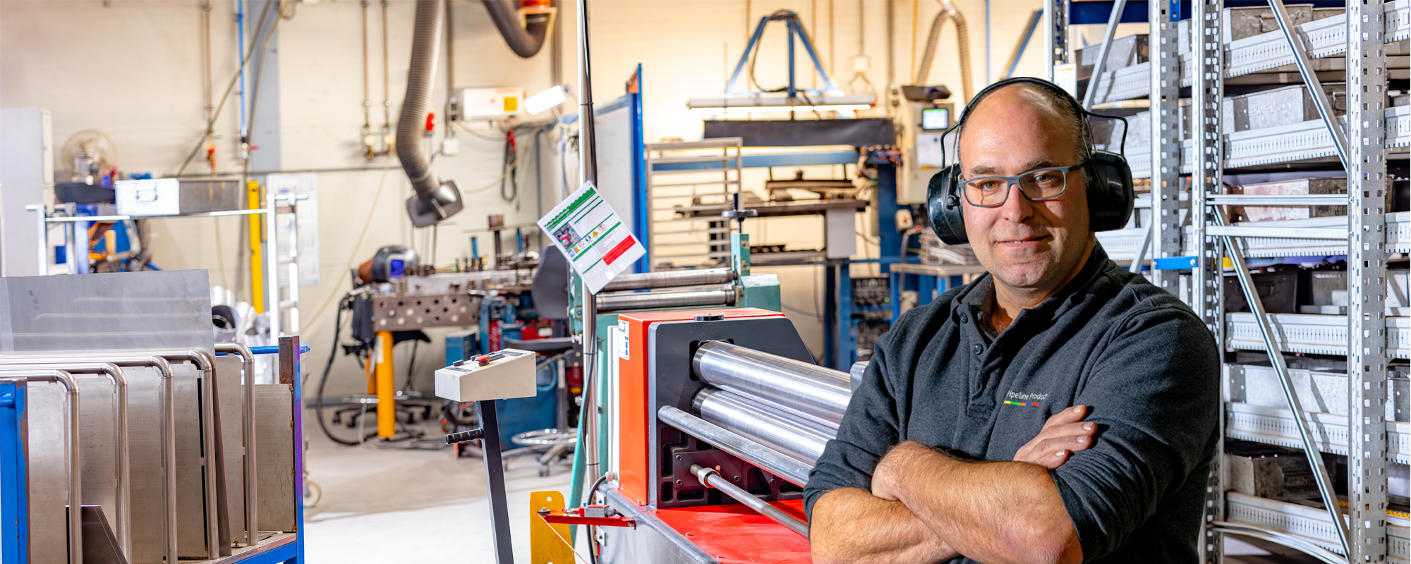
Toolbox Harmful noise
Company name and date

Slide 2

Contents
Safe and healthy working practices | Harmful noise
What is harmful noise?
What are the health risks?
What does the Working Conditions Act say?
How do you tackle harmful noise?
How do we do that?

Slide 3
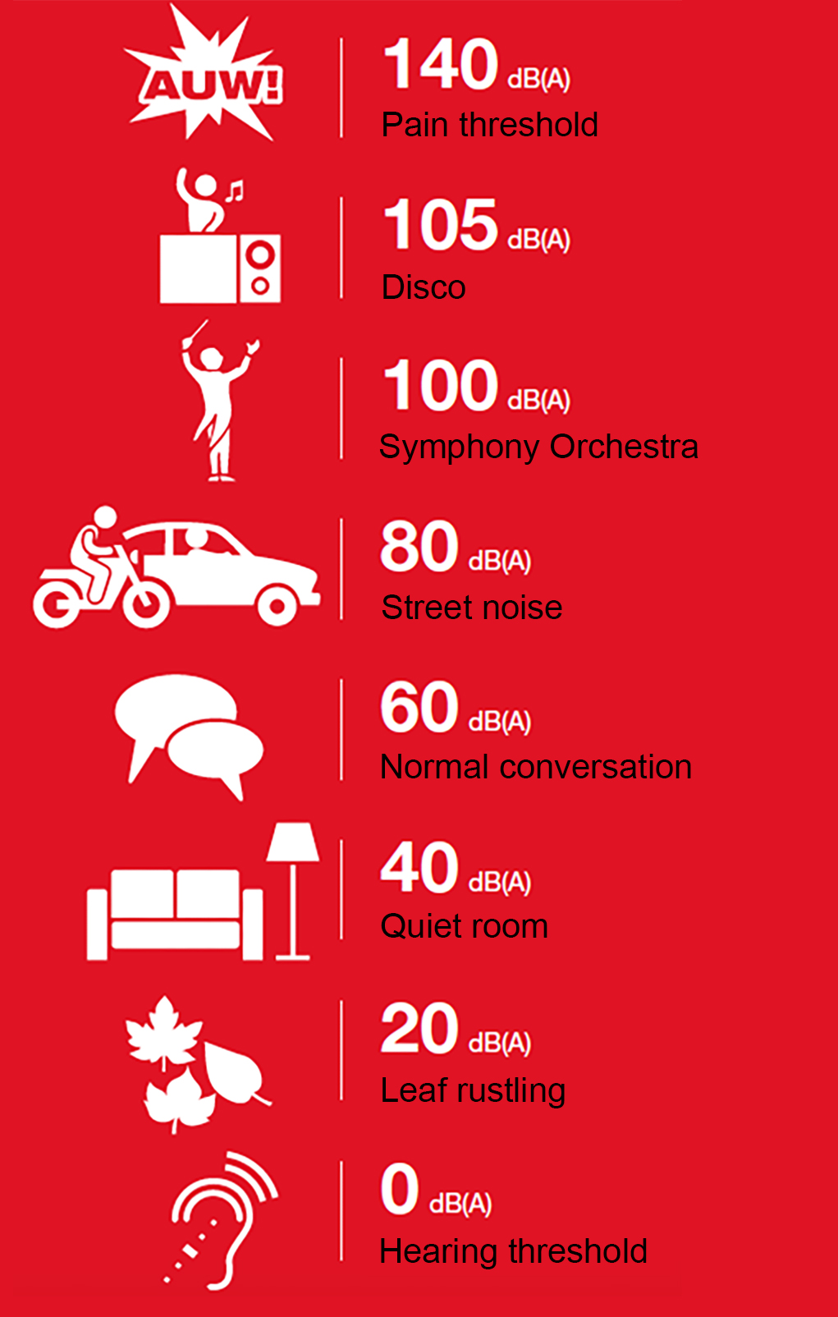
Safe and healthy working practices | Harmful noise
When is noise harmful?
Harmful noise always involves:
The volume > the number of decibels
The duration > how long you hear a noise that is too loud
Danger limit : 80 dB(A), 8 hours per day.
Notes:
https://www.nlarbeidsinspectie.nl/publicaties/rapporten/2024/08/26/monitor-arbeidsongevallen-2023
The accident type "Contact with work equipment or object" is common in the Industrial sector (42% of accidents in that sector). The majority of accidents involve accidents in which the victim came into contact with moving parts of a machine (69%).

Slide 4
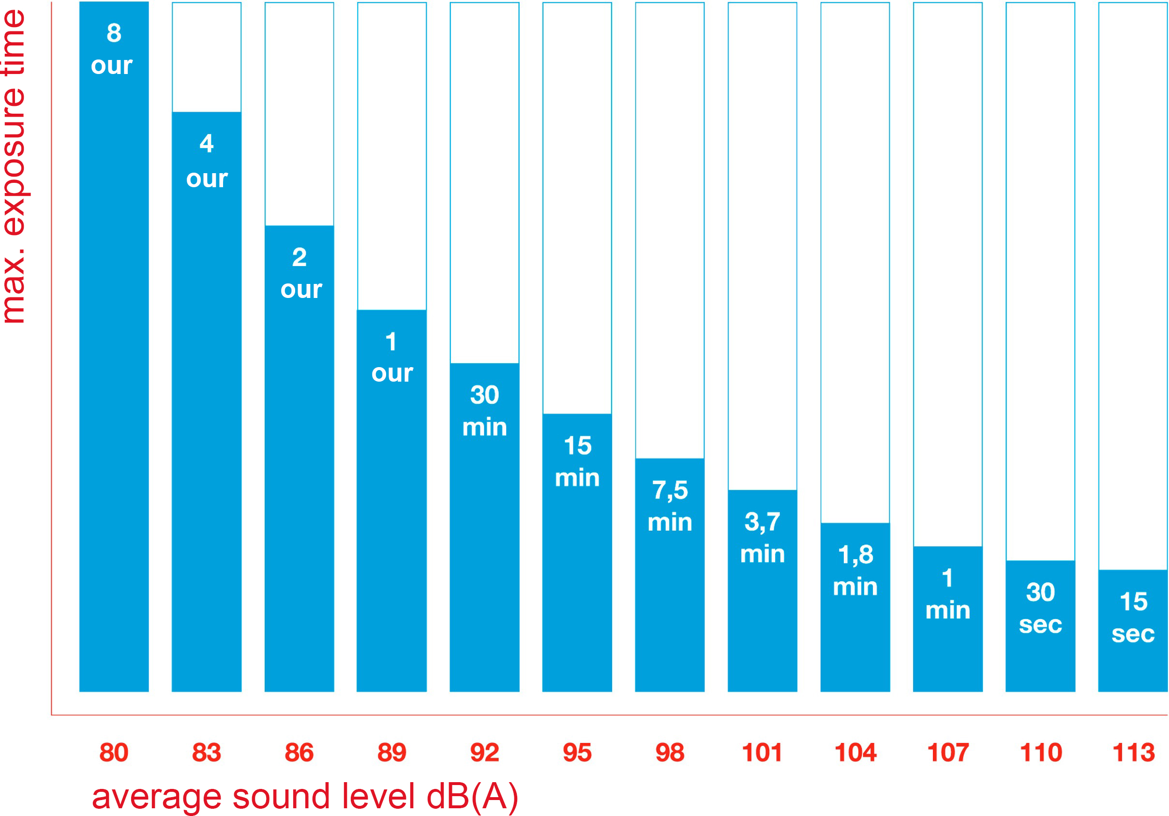
Safe and healthy working practices | Harmful noise
When is
noise harmful?
Notes:
https://www.nlarbeidsinspectie.nl/publicaties/rapporten/2024/08/26/monitor-arbeidsongevallen-2023
The accident type "Contact with work equipment or object" is common in the Industrial sector (42% of accidents in that sector). The majority of accidents involve accidents in which the victim came into contact with moving parts of a machine (69%).

Slide 5
Safe and healthy working practices | Harmful noise
Noise makers
Processing: Noise level in dB(A):
sawing with a band saw 70 - 85
welding: Electric 85
MIG 90 - 100
TIG 65 - 75
cutting 88 - 98
punching 90 - 110
hammering 95 - 110
grinding with an angle grinder 95 - 115
cleaning with compressed air 99 - 103

Slide 6
A. From 80 decibels
Safe and healthy working practices | Harmful noise
When is noise harmful?
B. From 85 decibels
C. From 90 decibels
Notes:
Answer A is correct

Slide 7
A. When you can no longer hear each other properly.
Safe and healthy working practices | Harmful noise
How can you recognise 80 decibels without measuring it?
B. When the noise is irritating.
C. When it hurts your ears.
Notes:
Answer A is correct

Slide 8
If you can hear each other clearly at a distance of one metre without raising your voice, the noise level is below 80 dB(A).
Safe and healthy working practices | Harmful noise
Rule of thumb

Slide 9
outer ear
Safe and healthy working practices | Harmful noise
middle
ear
inner ear
The ear
eardrum
auditory nerve
ear canal
ossicles
cochlea
vestibular system

Slide 10


Safe and healthy working practices | Harmful noise
Damage to hair cells
Notes:
Top left: healthy hair cells/cilia.
It's all about the cilia in the inner ear. They are constantly processing sound, because sound is present everywhere and at all times.
Loud noises, from 80 decibels, can damage hearing. The cilia become overloaded by the sound pressure and break down. This can cause them to transmit incorrect signals, such as tinnitus.

Slide 11
Hearing damage is gradual: - Temporary hearing loss is already an important sign. - Permanent hearing loss can start with tinnitus and lead to irreparable damage to hair cells.
Safe and healthy working practices | Harmful noise
It will gradually become quiet...
When our hearing deteriorates, it can also lead to the following physical and psychological reactions: heart palpitations, nervousness, poor sleep, irritability, increased blood pressure, fatigue, stomach/intestinal disorders.

Slide 12
Approximately 1 in 10 young people under the age of 25 in the Netherlands always have a ringing or buzzing in their ears. The World Health Organisation (WHO) states that half of young people aged 12 to 35 regularly find themselves in harmful listening situations. There are no exact figures, but according to the Municipal Health Service, thousands more young people develop serious hearing problems, such as tinnitus, every year.
Safe and healthy working practices | Harmful noise
It will gradually become quiet...
Thirteen percent of the Dutch population aged 40 and older has hearing loss of more than 35 decibels. That amounts to 1.2 million people who have difficulty understanding others in everyday life and who could benefit from a hearing aid.
Notes:
Source:
https://www.veiligheid.nl/kennisaanbod/onderzoek/rapport-12-miljoen-mensen-leden-2020-aan-gehoorverlies-nederland

Slide 13

Peeping
Safe and healthy working practices | Harmful noise
It will gradually become quiet...
Tinnitus / ringing in the ears
Hissing
Combination
Notes:
Tinnitus affects approximately two million people in the Netherlands.
They hear sounds such as hissing, ringing, or whistling, high or low, loud or soft, combinations of sounds, continuously or intermittently.
*Source: https://www.kno.nl/patienten-informatie/oor/oorsuizen/#tinnitus

Slide 14
Safe and healthy working practices | Harmful noise
Hearing loss
caused by noise
is irreversible!
Be aware that there are many sources of noise in the metal industry.

Slide 15
> 80 dB(A): hearing protection must be available. > 85 dB(A): mark the areas where wearing hearing protection is mandatory.
Safe and healthy working practices | Harmful noise
Health & Safety Act obligations
Employer obligations
Assess whether harmful noise is present.
Limit exposure to harmful noise as much as possible.
Monitor the situation.
Offer employees regular hearing tests.
Provide information about the risks and consequences of harmful noise.
Employee obligations > 85 dB(A): mandatory use of hearing protection.

Slide 16
Reduce noise at source. For example, by choosing a quieter machine.
Safe and healthy working practices | Harmful noise
Approach to harmful noise
Reduce noise transmission to others. Consider encasing a machine.
Prevent prolonged exposure to harmful noise. Consider solutions such as changing tasks or workplaces.
Provide the most suitable (and comfortable) hearing protection equipment. And wear it!

Slide 17
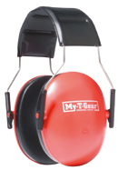
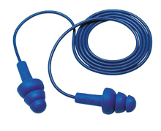
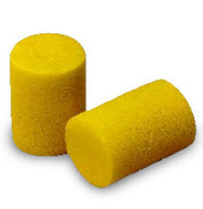
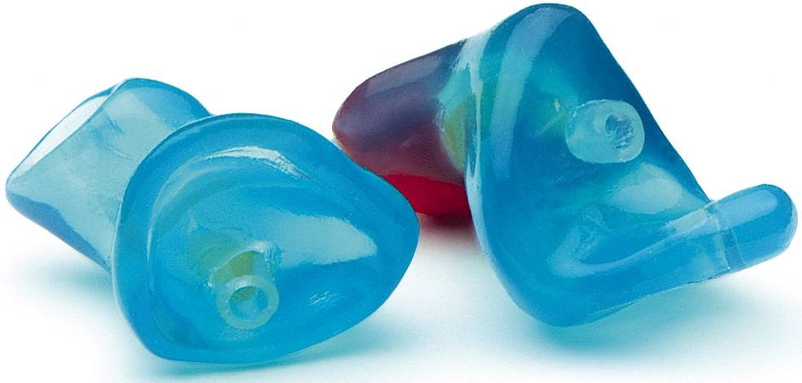
10 - 15 decibels
Safe and healthy working practices | Harmful noise
Hearing protection
5 - 30 decibels
10 - 15 decibels
5 - 30 decibels

Slide 18
Safe and healthy working practices | Harmful noise
Statement
Is noise cancelling also hearing protection?
Yes
No
Notes:
Answer: NO
While noise-canceling headphones are excellent at reducing ambient noise, they are not designed to protect your hearing. Traditional hearing protection, such as earplugs or earmuffs, is specifically designed to block out noise and protect your hearing from harmful levels of noise.
See next slide

Slide 19
Safe and healthy working practices | Harmful noise
Noise cancelling
Hearing protection must comply with the EN352 standard. Your phone's earphones do not comply with this standard.
Additional hazard: earphones hinder communication, making it difficult to warn others in an emergency because ambient noise is filtered out.

Slide 20
Safe and healthy working practices | Harmful noise
How do we do that?
Are there places where it is often or always impossible to hear each other at a distance of one metre with a normal voice, i.e. without raising your voice?
Are there places where there is sometimes a lot of noise, making it impossible to hear each other at a distance of one metre with a normal voice?

Slide 21
Safe and healthy working practices | Harmful noise
How do we do that?
What measures can be taken in this company to reduce (harmful) noise?

Slide 22

Conclusion

Slide 23
Safe and healthy working practices | Harmful noise
So
Wear hearing protection!
It can prevent damage.
It can prevent or slow down the worsening of damage (if damage has already occurred).
If you have any ideas for reducing harmful noise, discuss them with your manager.

Slide 24

Safe and healthy working practices | Harmful noise
Questions?
info@5xbeter.nl | www.5xbeter.nl

Slide 25
Safe and healthy working practices | Harmful noise
Need help?
Discuss it with your manager or contact the health and safety officer.
Consult an Improvement Coach from 5xbeter: www.5xbeter.nl
Or call the FREE Improvement Line: 0800 – 55 55 005
info@5xbeter.nl | www.5xbeter.nl

